Slide 1

Automatic Image Captioning Final Presentation Group-15, Cohort-20
,
Mentor: Brahmani Nutakki
Team (3): Hanumanth Sangewar, Ritesh K Singh and Raheem Baig
26th August 2023

Slide 2


Thank You
Prof. Vineet Gandhi and Mentor. Brahmani Nutakki
Thank You for Prof. Vineet Gandhi for igniting new ideas to explore and pushing to next level on learning.
All Prof of IIIT-H
Prof. Jawahar CV, Prof. Anoop N, Prof. Manish S, Prof. Anil Kumar V , Prof. Vineet Gandhi
Dr. Manish Gupta (Microsoft)
TalentSprint Team for offering Structured AIML PG Course
Ramendra and Mentor team – mentoring and clarifying queries throughout the course
Abhinav (and All Support team) – providing resources in time during the complete duration of course.
Prof. Asokan Pichai
Dr. Habeeb
Thank You Brahmani Nutakki for mentoring each stage of capstone project and providing all resources and guidance in resolving issues.
Prof. Arulalan R (ext Faculty : Maths)

Slide 3
Status Summary
Completed
Debug & Fine-tuning models in Collab
FastAPI deployment on Local PC
GitHub Archive and Document
In Progress
Work in progress for Web deployment using back4app.com
Training Different Models (ResNet 80)
Challenges are seen with system crashes and long duration to complete training.
Future/Opportunities
Explore Implementations
VGG16 & LSTM + 8K with BLEU scores (Max): ~0.54
Inception_v3 & LSTM + 8K with BLEU scores (Max): ~0.51
ResNet50 & LSTM + 30K with BLEU scores (Max): ~0.91
Deployed multiple models to generate captions on same image
Cascaded LSTM
Transformers

Slide 4
Learnings (1/2)
Overall, Experienced as Core Developer during the capstone project phase
Setup development Environment in local PC – reduce dependency on G- Collab
Thanks to our Mentor Brahmani Nutakki for guiding us in solving all the setup issues
She helped us to make progress step-by-step, in every stage of the project
GIT, VSCode, JupyterLab as development environment in local PC.
Earlier during the course – Everything was in Google Collab & TalentSprint-LMS
Used requirements.txt to overcome setup issues between team members
Various challenges in the installation of packages and imports
long paths, AttributeError: module 'collections' has no attribute 'Callable’ (modify ‘py3k_compat.py ’)
In the training, used “import logging” to write debug log messages to a file
FastAPI deployment and Basics of HTML & templates.
Use the trained model (.h5 and .pkl) in Python code on the local PC
How to output images in the deployment
Used GitHub initially to select images and then updated to select any of the 8k images saved on the local PC
User Interface to select an image to generate captions
Deployed multiple modes to generate captions of the same input image

Slide 5
Learnings (2/2)
Collaborate and Archive progressive development in GitHub
Started training team members @ workplace – KEY is The Confidence Gained in Capstone Project
Tested different models
VGG16, ResNet50 & Inception_v3 - Encountered challenges and lessons leant.

Slide 6
Challenges
Identified the missing images & respective captions updated
Dataset was updated to map captions to image features.
Initially, used GitHub as a temp solution to save input images, then learned HTML templates and updated .py code & UI.
Web Deployment – storing model (.h5) & features (.pkl) – exploring to use Git LFS
Due to system limitations, testing was longer time and crashes observed.
Reduced epochs and using data in small batches.
Created a new module to deal with it and easy to load dev, test and train dataset.
Above module gave us the liberty to use data in small chunks to keep it going
During Course time, it was Quick learning – balancing office work, lab tests, MH1, MH2 & main-H per Unit, then Weekly CFP & CFU – Now Feel Confident after connecting dots in Capstone
Challenges in moving from G-Collab to local PC and now its Full-Fledged Local deployment

Slide 7
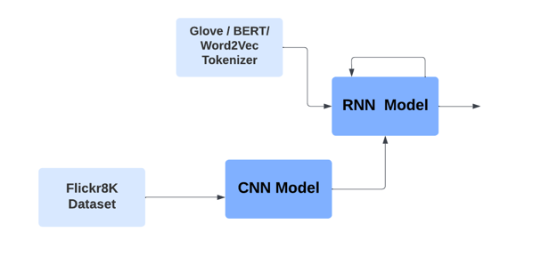
Implementation

Slide 8
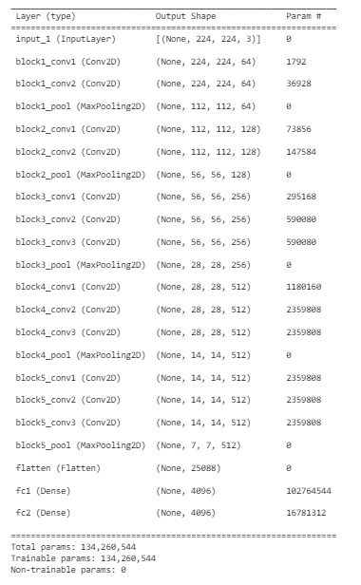
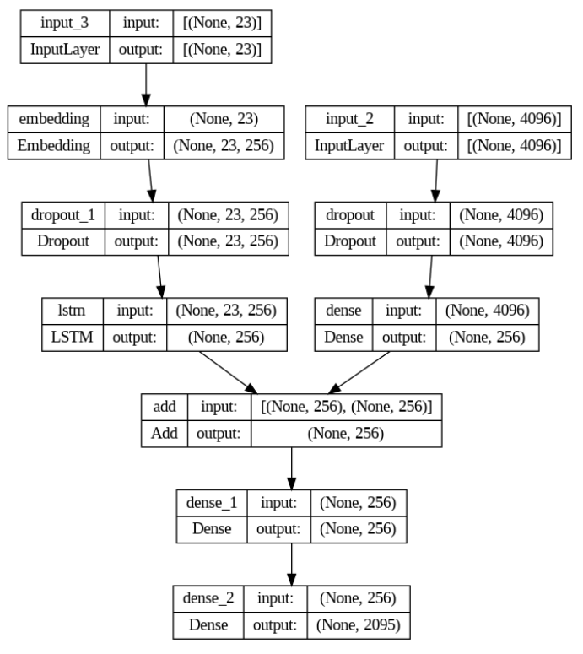
Implementation
VGG16
CNN + LSTM

Slide 9
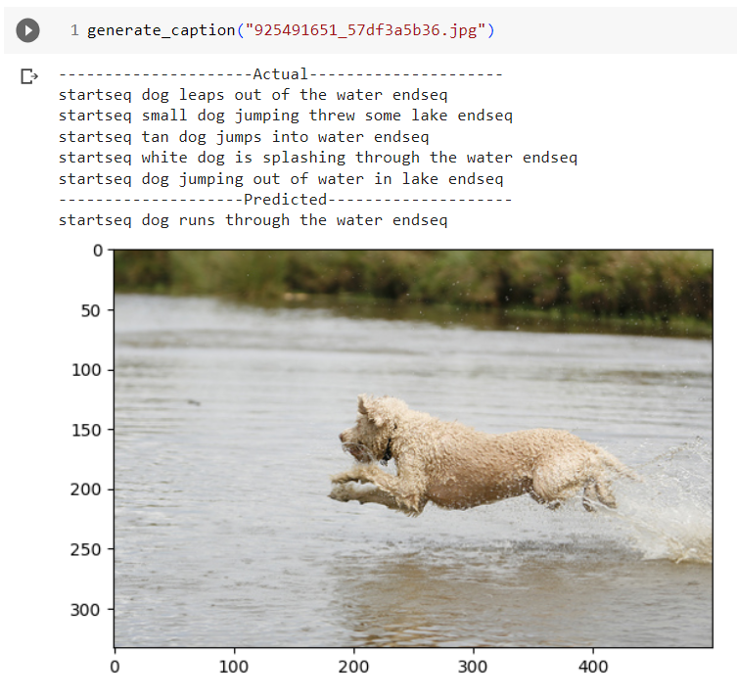
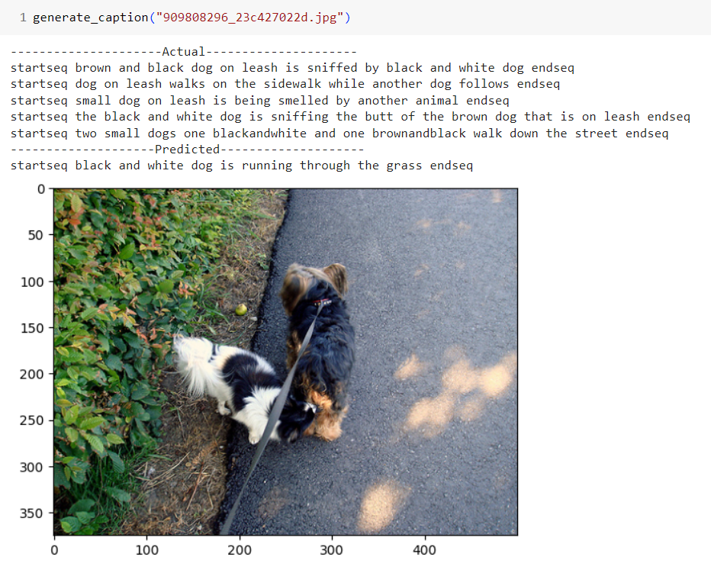
Results of Trained Model in G-Collab

Slide 10
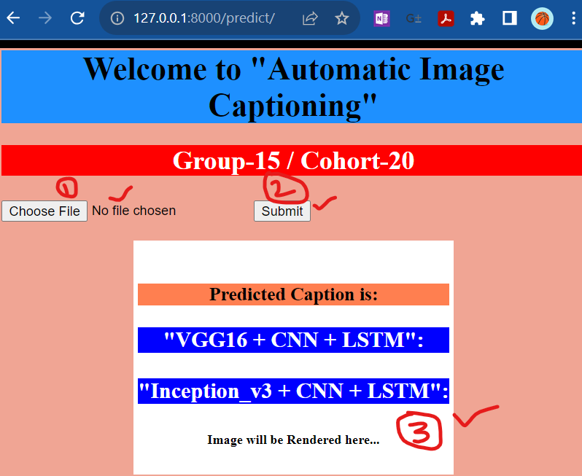
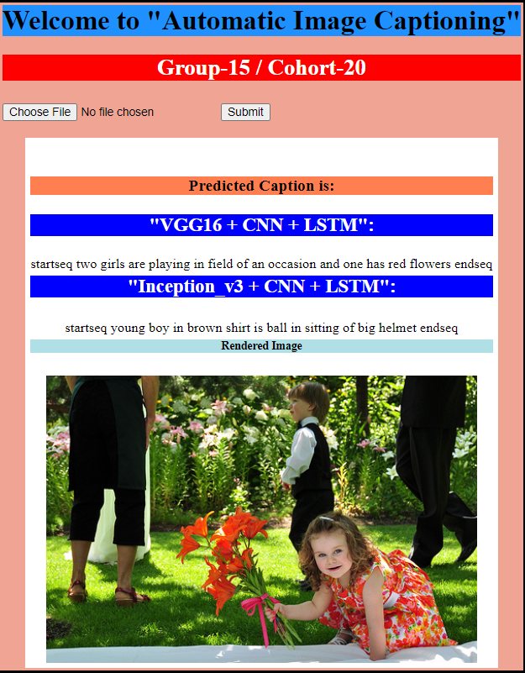
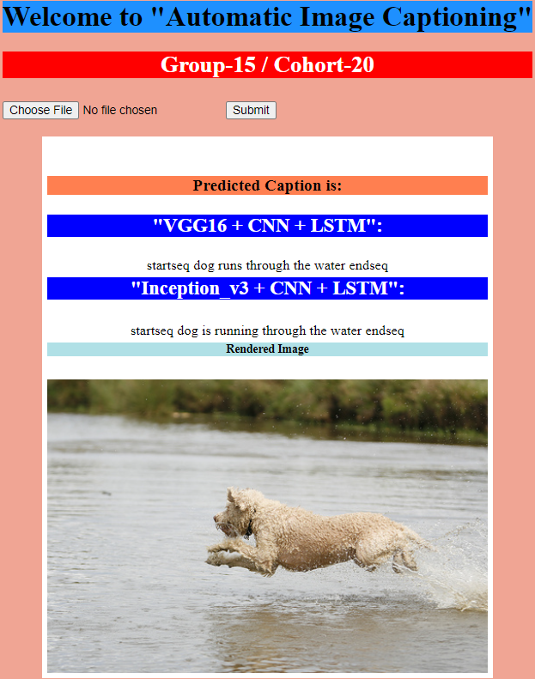
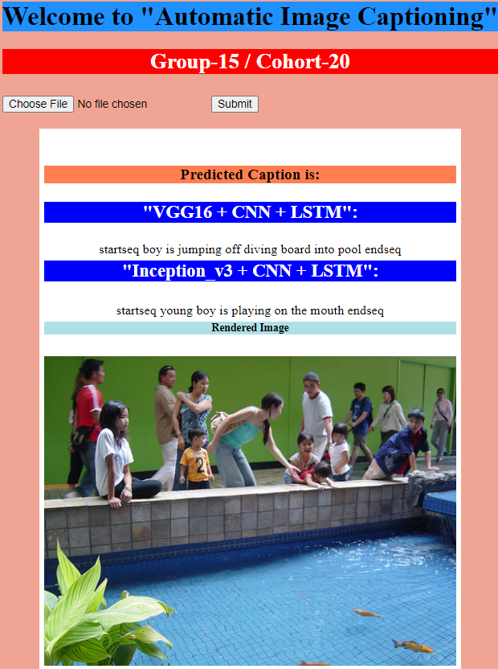
FastAPI Deployment (Local PC)

Slide 11
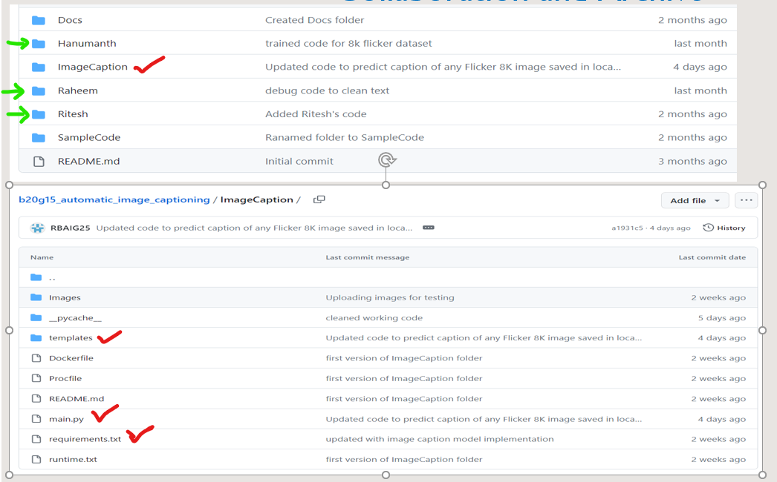
Collaboration and Github Archive

Slide 12


Slide 13
Backup Slides from Phase#1 & #2 Review

Slide 14
Automatic Image Captioning Phase-2 Review Group-15, Cohort-20
,
Mentor: Brahmani Nutakki
Team (3): Hanumanth Sangewar, Ritesh K Singh and Raheem Baig
12th August 2023

Slide 15
Phase 2: Status Summary
Completed
Debug & Fine-tuning of VGG16 & LSTM model in Google-Collab
FastAPI deployment on Local PC
GitHub Archive
In Progress
Work in progress for Web deployment using back4app.com
Training Different Models (ResNet 80, Inception v3)
Challenges are seen with system crashes and long duration to complete training.
Future/Opportunities
Training model with Flicker 30k dataset
Use Cascaded LSTM
Explore Implementation based on Transformers.
Project Documentation and Prepare for final presentation.

Slide 16
Learnings
In the training, used “import logging” library to write debug log messages to a file
Setup development Environment in local PC – reduce dependency on Google Collab (using only to refer course material)
Thank You to our Mentor Brahmani Nutakki for guiding us in solving all the setup issues
She helped us to make progress step-by-step, in every stage of the project
Used requirements.txt to overcome setup issues between team members
Various challenges in the installation of packages and imports
FastAPI deployment and Basics of HTML & templates.
Use the trained model (.h5 and .pkl) in Python code on the local PC
How to output images in the deployment
User Interface to select an image to generate captions
Used GitHub initially to select images and then updated to select any of the 8k images saved on the local PC
Collaborate and Archive progressive development in GitHub
Started training team members @ workplace – KEY is The Confidence Gained in Capstone Project
Tested different models (ResNet 80 & Inception v3) and encountered challenges and lessons leant.
long paths, AttributeError: module 'collections' has no attribute 'Callable’ (modify ‘py3k_compat.py ’)

Slide 17
Challenges
Identified the missing images & respective captions updated
Dataset was updated to map captions to image features.
Initially, used GitHub as a temp solution to save input images, then learned HTML templates and updated .py code & UI.
Web Deployment – storing model (.h5) & features (.pkl) – exploring to use Git LFS
Due to system limitations, testing was longer time and crashes observed.
Reduced epochs and using data in small batches.
Created a new module to deal with it and easy to load dev, test and train dataset.
Above module gave us the liberty to use data in small chunks to keep it going
During Course time, it was Quick learning – balancing office work, lab tests, MH1, MH2 & main-H per Unit, then Weekly CFP & CFU – Now Feel Confident after connecting dots in Capstone
Challenges in moving from G-Collab to local PC and now its Full-Fledged Local deployment

Slide 18
Results of Trained Model in G-Collab

Slide 19
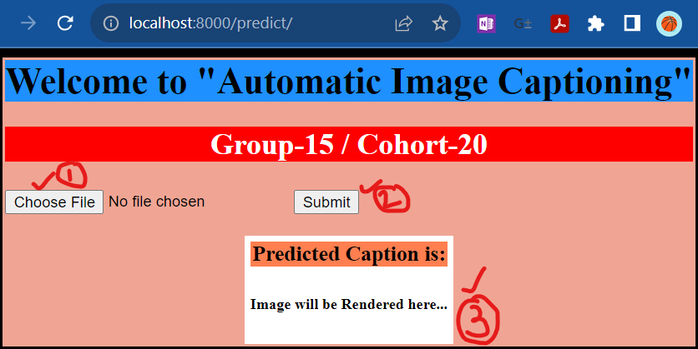
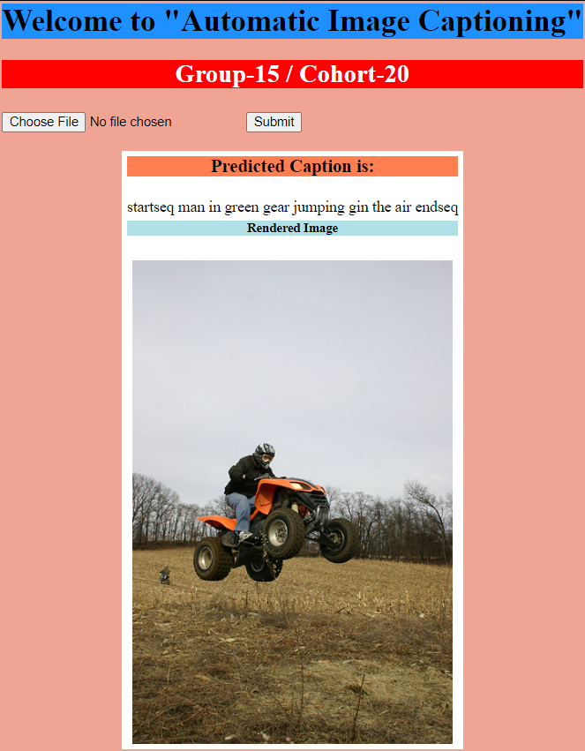
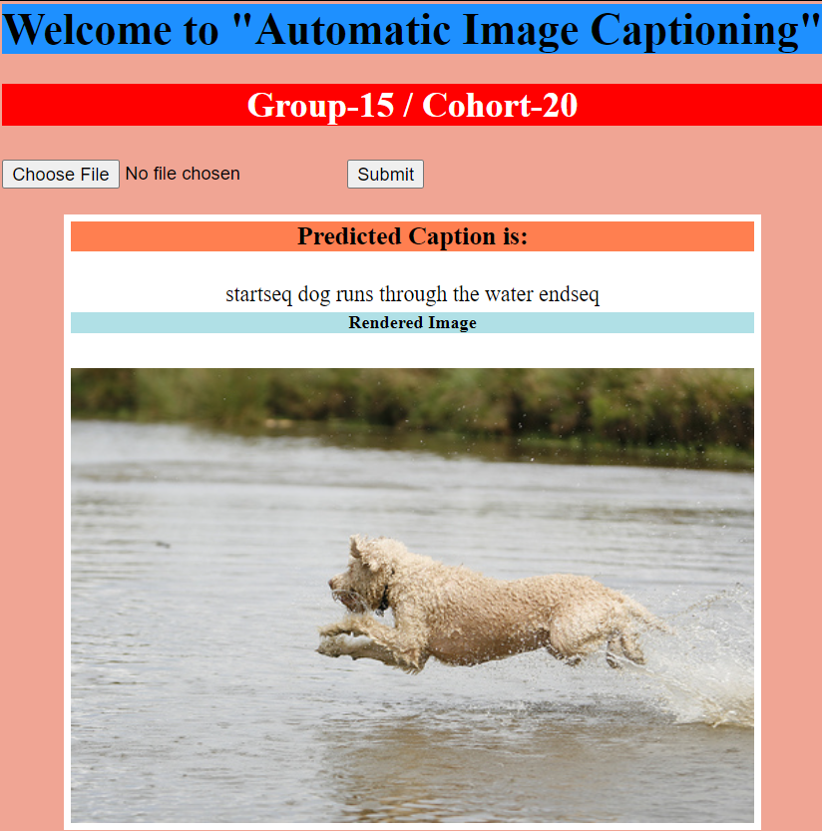
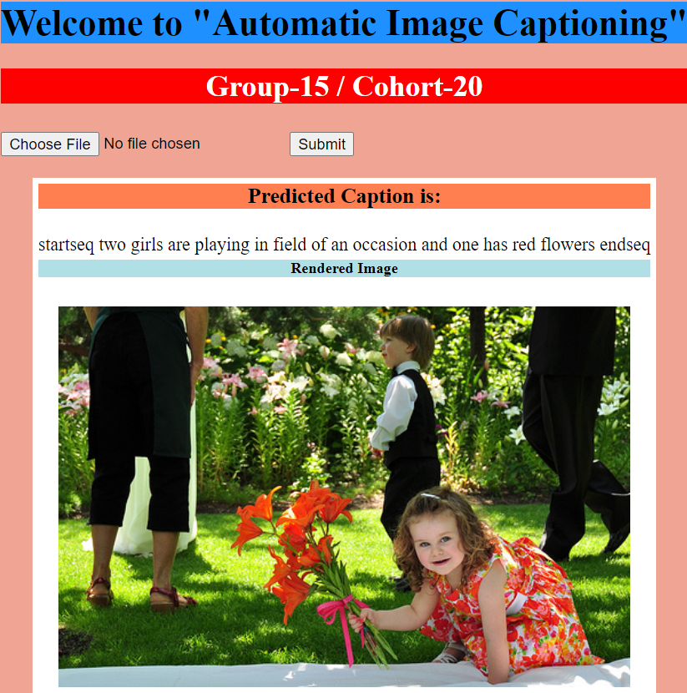
FastAPI Deployment

Slide 20
Collaboration and Github Archive

Slide 21
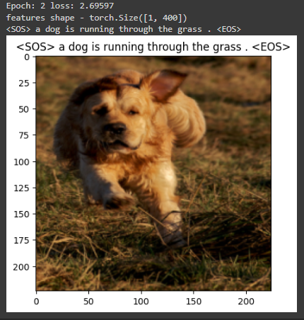
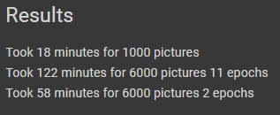
Resnet80

Slide 22
Timelines
Train model using 30K Flicker dataset
Web deployment using back4app.com & render.com
Learn from different implementations (Cascaded LSTM/Transformers)
Prepare final documentation and present the learning and status.
Deploy model to local server and test
Fine Tune the model to 8K based on challenges
Complete Archive in GitHub
1st Draft Project document
Complete debug & fine-tuning the model to the 8K dataset
Use other implementations available (ResNet 80 and Inception v3)
Literature Reading
Understand available implementation
Project Proposal
Implement model
Train and test for 8K Flicker Dataset
Phase#4 – 26th Aug’23
Phase#3 – 12th Aug’23
Phase#2 – 16th July’23
Phase#1 – 1st July’23

Slide 24
Backup Slides from Phase1 Review 8th July 2023

Slide 25
Phase 1: Status Summary
Research/Study
Various papers (arxiv.org), AIML-related internet content, and Kaggle solutions
Understand the various implementations available and learn from available code
Got hands-on with various tools, setup, and Python AIML libs
GIT – created a new repository & practice how to co-work as a team
Local setup (VSCode and JupyterLab) – To work on code development individually
Learnt Python logging and used it to fine-tune the model implementation
Implementation
Selected model based on the research and reference code
CNN for training images – used VGG16 to extract the features
Applied Various Text Clean/process techniques and Tokenized
Caption Generation - Used LSTM to generate captions from the feature vectors and tokens fed to it.
Base model ready with training done on entire flickr8K dataset and reviewed by Mentor

Slide 26
Learning and Challenges
Learnings:
Overall, Experienced as Core Developer during the capstone project phase, after a long time
How to generate feature vectors from the images using CNN.
How to feed both feature vectors and tokens to an LSTM network.
GIT, VSCode, JulyperLab, Python Logging, and setting up the development environment in local PC.
All learning earlier during the course was in Google Collab & TalentSprint-LMS.
Literature Research, refer to internet content and understand the available/implemented code to design our project model,
Challenges:
Encountered issues in training the base model on the entire flickr8K dataset,
Google Collab session was crashing frequently.
Shifted development environment to Ipython/ VS4 to get around crash issues
Caption Generation was tricky
Some captions were empty after initial text cleaning
Used Python Logging libs to debug and fine tune Caption
There were some missing images corresponding to captions present in the tokens file
After a keen look at the logging and images vs captions, we found missing images and corrected/removed the related captions.

Slide 27
Implementation
CNN -VGG16
CNN + LSTM

Slide 28
Timelines
Present a Summary of 3 research papers
Prepare final documentation and present the learning and status.
Deploy model to local server and test
Fine Tune the model to 8K based on challenges
Complete debug & fine tuning the model to 8K dataset
Use the 8K dataset experience to 30K Flicker dataset
Use other implementations available
Literature Reading
Understand available implementation
Project Proposal
Implement model
Train and test for 8K Flicker Dataset
Phase#4 – 12th Aug’23
Phase#3 – 30th July’23
Phase#2 – 16th July’23
Phase#1 – 1st July’23

